Slide 1

School of Computing Science and Engineering
Medical Insurance Cost Prediction Using Machine Learning
This project uses machine learning to predict medical insurance costs. It aims to help insurance companies and individuals make informed decisions.
Presented By: BT40113
Piyush Tripathi - 21SCSE1180046
Vaibhav Singh - 22SCSE1010550

Slide 2
Abstract
This project focuses on developing a predictive model for estimating medical insurance costs using Machine Learning (ML). The primary objective is to leverage ML techniques to create an accurate and reliable tool for forecasting insurance expenses based on key variables such as age, gender, BMI, smoking status, and geographical region. The project begins with the collection and preprocessing of a comprehensive dataset to ensure its quality and relevance. After cleaning and preparing the data, it is divided into training and testing subsets. This division is crucial for building a robust model and subsequently evaluating its performance. We employ a linear regression algorithm for this task, chosen for its simplicity and effectiveness in handling continuous output variables. During the training phase, the model is fitted to the training data, allowing it to learn the relationships between the independent variables and the dependent variable—medical insurance costs. Once the model is trained, its predictive accuracy is assessed using the testing subset. This evaluation helps ensure that the model generalizes well to new, unseen data. The resulting model is expected to provide precise insurance cost predictions, which can be invaluable for insurance companies in policy pricing and for individuals in financial planning. Ultimately, this project demonstrates the practical application of ML in the financial domain, highlighting its potential to improve decision-making processes and enhance economic efficiency through accurate predictions and data-driven insights.
Program Name: B.Tech (CSE)

Slide 3
Understanding the Problem: Factors Influencing Medical Insurance Costs
Demographics- Age, gender, and location play a significant role in determining insurance premiums.
Health History- Preexisting conditions, medical treatments, and claims history affect risk assessment.
Lifestyle Factors- Smoking habits, exercise levels, and dietary choices impact health outcomes and costs.
Rising Healthcare Costs- Predicting insurance costs helps insurance providers and policyholders.
Benefits for Insurers- Optimize pricing, manage risk, and offer tailored plans.
Benefits for Individuals- Better financial planning and decision-making.
Program Name: B.Tech (CSE)

Slide 4
Data Collection and Preprocessing
Data Sources- Insurance claims records, medical records, demographic data, and lifestyle surveys.
Data Cleaning- Handling missing values, removing duplicates, and addressing inconsistencies.
Data Transformation- Converting categorical variables into numerical ones and scaling features for model training.
Program Name: B.Tech (CSE)

Slide 5
Literature Review
Early Efforts- Big data analytics for health insurance (Gupta & Tripathi, 2016).
Mobile Systems- Personalized recommendations (Shakhovska et al., 2019).
Advanced ML- Deep neural networks for cost prediction (Hanafy & Mahmoud, 2021).
Program Name: B.Tech (CSE)

Slide 6
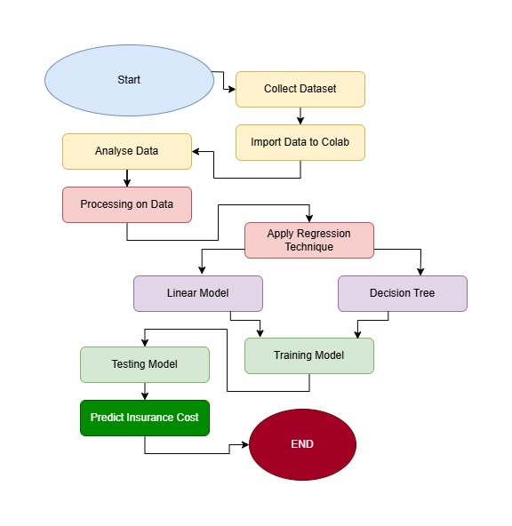
Design Flow and Process
Feature Selection
Demographic, health-related, and socioeconomic factors.
Design Constraints
Privacy standards, cost, ethical considerations.
Design Selection
Advanced Machine Learning Flow for accuracy and scalability.
Program Name: B.Tech (CSE)

Slide 7
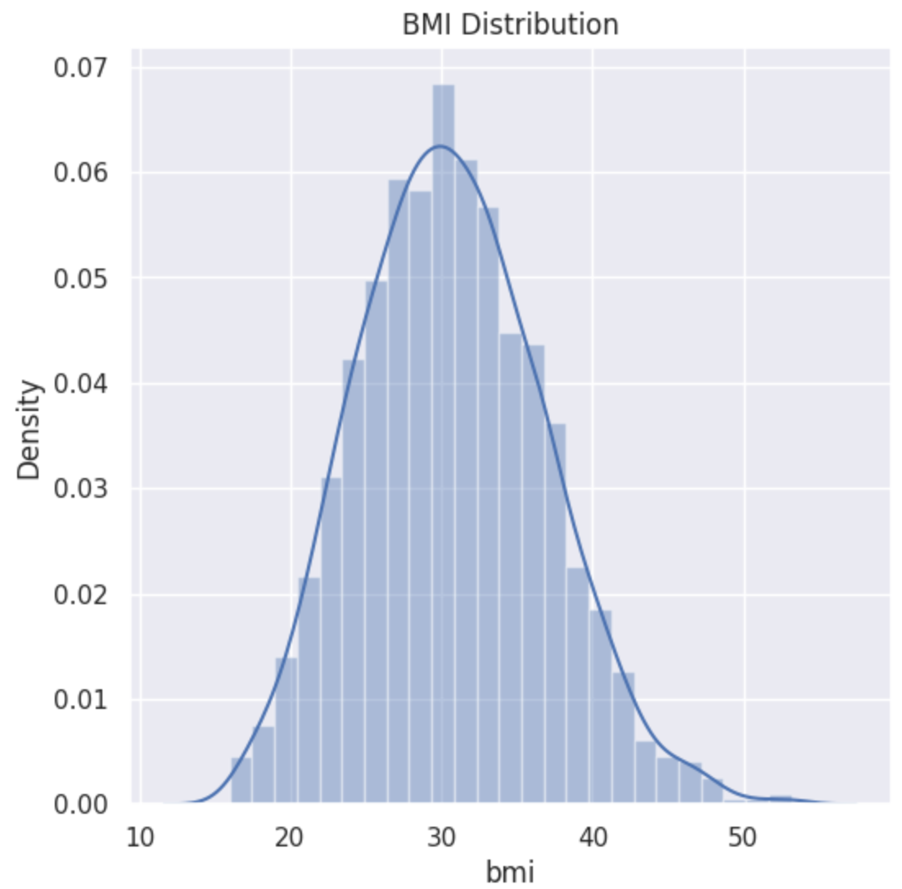
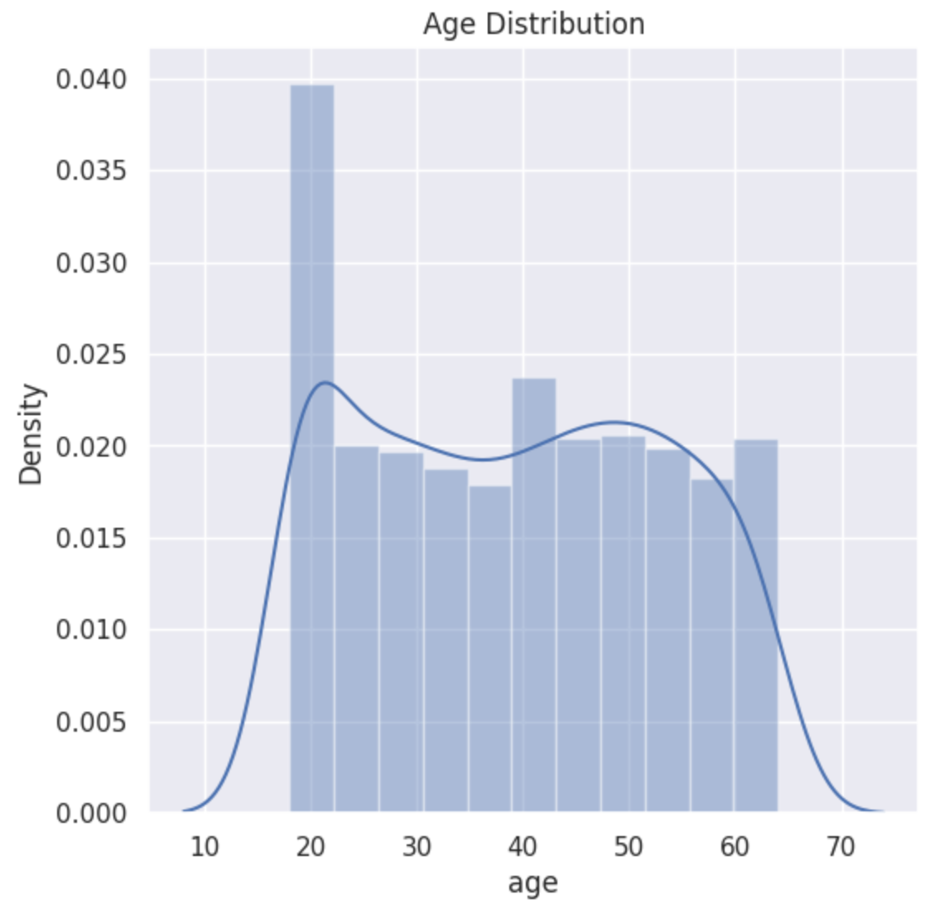
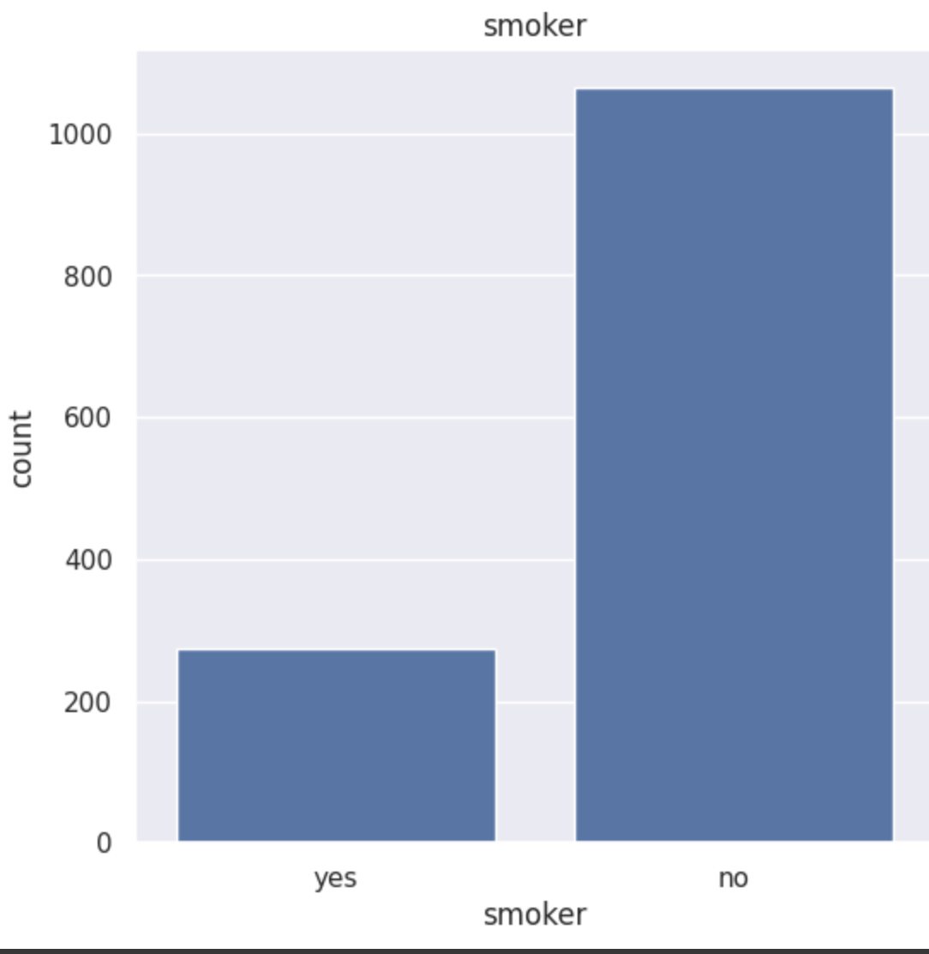
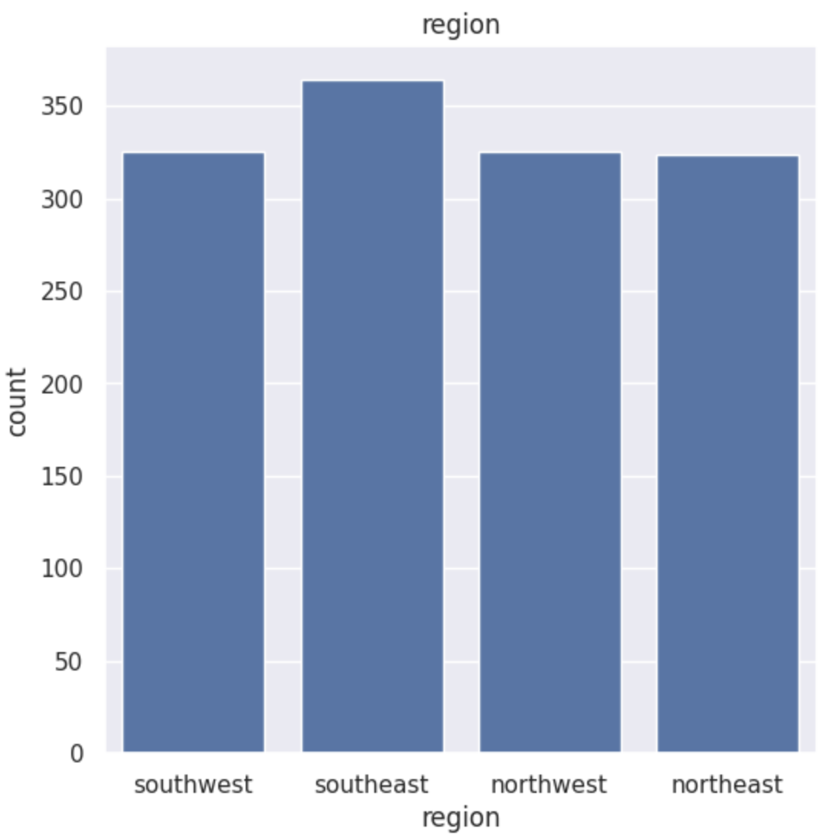
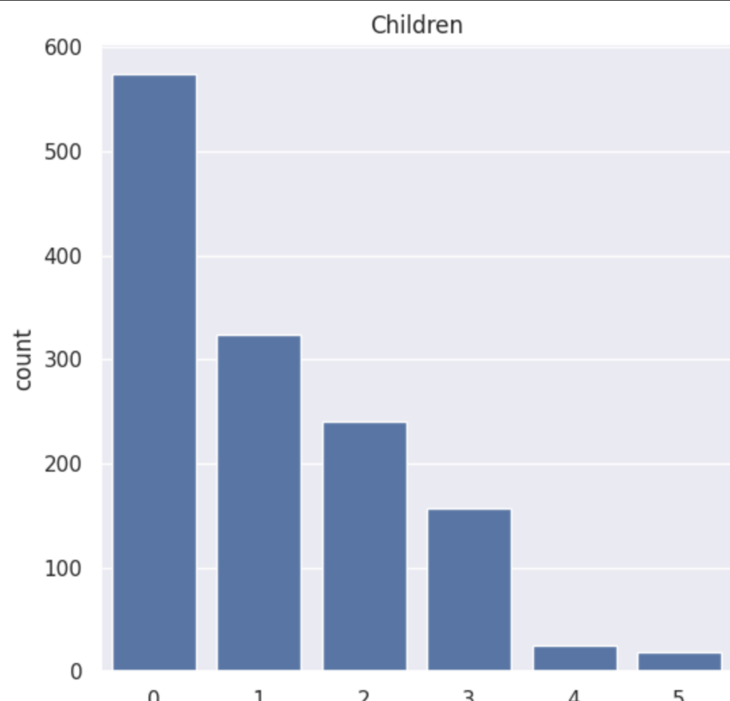
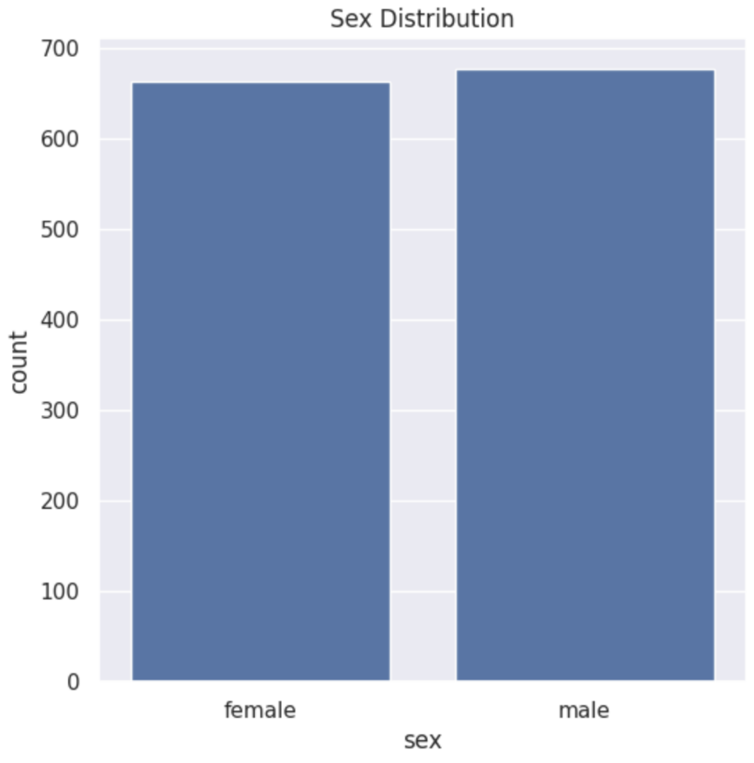
Data Analysis and Feature Distribution
Program Name: B.Tech (CSE)

Slide 8
Model Training and Evaluation
Data Splitting- 80-20 split for training and testing.
Model Training- Linear Regression model applied, R-squared = 0.7515. Decision Tree = 1
Model Testing- Test set R-squared = 0.7447, good generalization. Decision Tree = 0.6856
Program Name: B.Tech (CSE)

Slide 9
Addressing challenges and limitations
Data Quality- Incomplete, inaccurate, or biased data can affect model accuracy.
Model Complexity- Overly complex models may overfit the training data and perform poorly on new data.
Ethical Considerations- Ensuring fairness and transparency in the use of predictive models.
Program Name: B.Tech (CSE)

Slide 10
Conclusion
The objective of this project was to develop a predictive model for estimating medical insurance costs based on various demographic and health-related factors such as age, gender, BMI, number of children, smoking status, and geographical region. Using a Linear Regression approach, the model demonstrated a satisfactory performance with R-squared values of 0.7515 on the training set and 0.7447 on the test set, indicating that the model captures a substantial portion of the variance in the dataset.
The Decision Tree Regressor offered a perfect fit to the training data with an R-squared value of 1.0. However, its R-squared value on the test set was 0.6856, suggesting a tendency to overfit the training data. Despite this, the Decision Tree model proved its ability to capture non-linear relationships in the data, which Linear Regression could not fully address
The results validated that factors like BMI, smoking status, and age significantly impact insurance costs, aligning with medical and economic expectations. The model was able to generalize reasonably well, providing accurate predictions even on unseen data points. By integrating the model into a predictive system, users can input their data to obtain cost estimates, offering a practical application for insurers and individuals alike.
Program Name: B.Tech (CSE)

Slide 11


